Slide 1

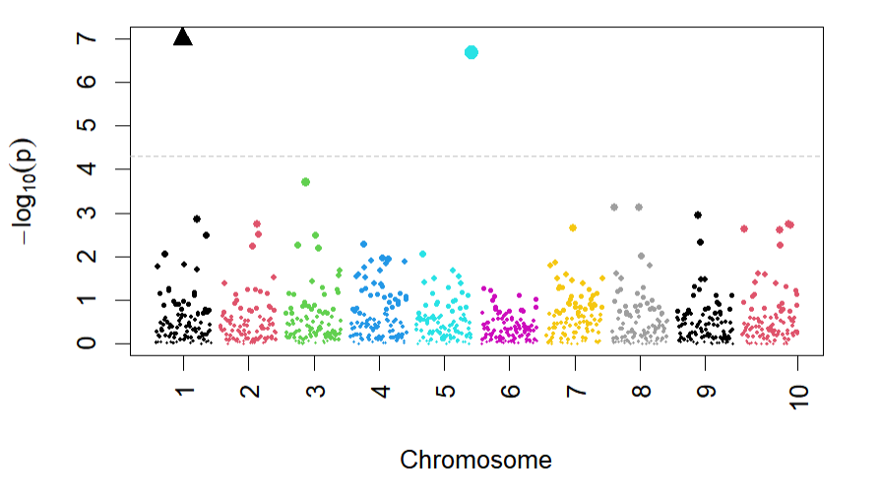
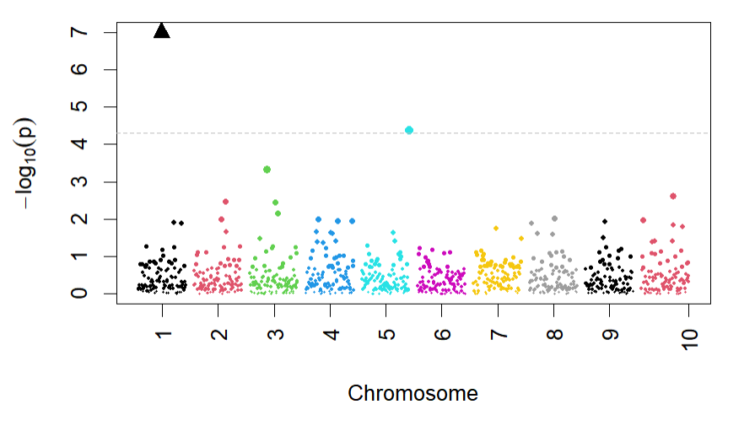
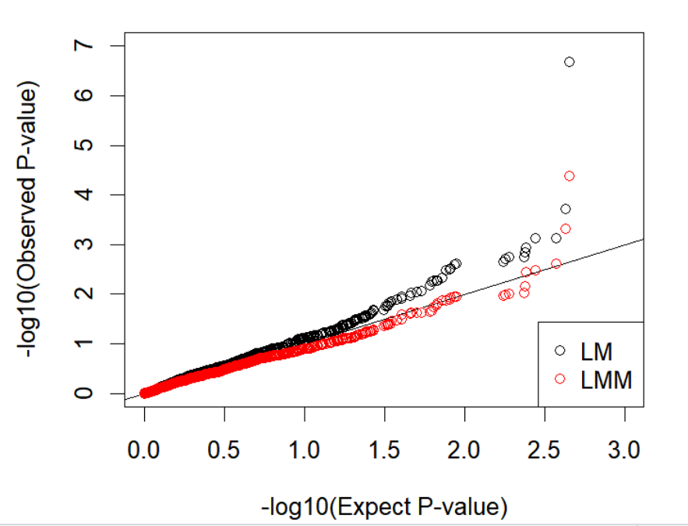
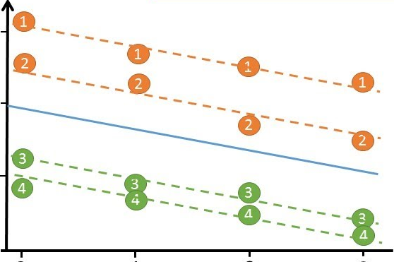
Applying Linear Mixed Model in Correlated Genetic Data
STAT 494 Statistical Genetics: Final Project
Krypton Ma, Xiyu Li (Dec. 2022)
Introduction
How correlation leads to type I error in GWAS?
Study Design
GWAS (Genome wide association studies) is a popular statistical study to analyze associations between SNP (single-nucleotide polymorphism) and the trait of interest. SNP is a so-called “common variant” which occurred at a single nucleotide level in our DNA. There are around 4 to 5 million SNPs in a person's genome. For each SNP position, we receive a total of two alleles (DNA base) from each parent. For a single SNP, there are often a more prevalent allele (one type of DNA base), and another minor allele. For example, if two types of alleles present in a SNP position are A and T, then a person’s genotype fall into one of the three categories of: AA, TT, or AT. If the allele T is a minor one in the population, the person’s observation is directly the number of minor allele copies they have on this SNP (it can be 0, 1, or 2). Therefore, GWAS data is comprised of the number of minor alleles at each SNP for each observation.
The focus of our project stems from the fact that GWAS data often have correlation structures within, for example, relatives and families can be all included in one study. However, such correlations, if not corrected for, would skew our analysis where the predictors tend to have a smaller p-value, becoming more prone to type I error: we claim associations between SNPs and the trait where they are not causal factors.
This time we will apply a new, popular, and effective method in correcting such correlation data structure: Linear Mixed Model (LMM). It is very similar to ordinary linear regression technique (LM) except it also captures data variance and correlation (by examining genetic similarity) between people. Through the study, we demonstrated that LMM is a very powerful technique to adjust for correlation, as well a new solution to avoid type I error in modern GWAS studies.
Suppose we have a dataset where every one relates to each other, thus the observations are dependent. Then, if we carry out regression methods such as linear model, we would derive the slope coefficient β₁ with a smaller standard error (SE), because we assume independent observations and we “think” we have a very accurate understanding of the information available, boosting our confidence in determining the estimates. However, since the data is actually correlated, meaning we under-estimate the true standard error (i.e. the variability of the slope estimate).
A smaller SE will lead to an inflated/ larger test statistic (T) for the variable we investigate at, due to:
Test statistic (T) = (estimate - null value) ⁄ SE
Since test statistic measures how far our estimate is away from the null value (in which assumes null hypothesis is true), and p-value measures the probability of seeing our test statistic as more extreme, inflated test statistic will lead us to a smaller p-value and reject the null hypothesis, and stating associations. However, the discovered association is because of correlation rather than true statistical association. Therefore, type I error occurs if we do not control for people’s correlation structure.
To demonstrate that LMM can correct correlation between individuals (family structure), we designed experiments to apply both LMM and LM (as the control experiment) in two different datasets: related (exists correlation) and unrelated individuals (no correlation). We used real data from NCBI retiring HapMap Resource that contains data of 1457897 SNPs for 165 individuals all with European ancestry.
Data Preparation Methods:
Linkage Disequilibrium (LD) Pruning
We used LD pruning to select a set of independent SNPs to reduce correlation between SNPs. 101268 SNPs are remained after pruning.
Quality Control
We removed 23684 monomorphic SNPs from the data. Monomorphic SNPs are the one where all samples have the same genotypes. Their inclusion will lead to a NA in the analysis.
Separate out unrelated individuals
We used both the family information from the HapMap data and calculated the kinship matrix K based on the genotype data to separate unrelated individuals and arrived at two separate datasets:
Group A with 107 unrelated individuals (no correlation structure)
Group B with 165 individuals including related individuals
Select 1000 SNPs
To lower the calculation pressure while retaining enough data for testing, we selected the first 100 SNPs from chromosome 1 to chromosome 10 (1000 SNPs in total) as our predictor variables.
Simulated phenotypes
The HapMap data did not provide real phenotypic data. In order to test whether LMM can reduce the p-value inflation of null SNPs without affecting the p-value of causal SNPs and causing Type II error, we then simulated two phenotypes for both group A and group B (creating 4 datasets):
Null Phenotype: generate phenotypes randomly based on the normal distribution model with a mean of 50 and a standard deviation of 2
Causal Phenotype: generate phenotypes that based on the null phenotype and two causal SNPs (the 50th and 500th).
Run Model
We ran LMM and LM model for each the dataset below:
1) Group A with Null Phenotype
2) Group A with Causal Phenotype
3) Group B with Null Phenotype
4) Group B with Causal Phenotype
Results
Manhattan Plot:
A statistical plotting -log(p) of each SNP along its chromosome position. The horizontal dotted line indicates the significant threshold of 5* 10⁻⁵ (by Bonferroni correction, diving standard threshold 0.05 by SNP size). Across all four categories, we all observed a down-shrinking pattern where the p-values all becomes larger (recall that a greater value of -log(p) indicated a smaller p) in the linear mixed model output. It is also worth noting that in the two categories with causal phenotype (both correlated and non-correlated structure), the causal SNPs (shown as the black triangle and cyan blue circle) were both above the significant threshold. Although the linear mixed model corrected the p-values for most insignificant and null SNPs, it still kept the causal ones. Such results indicated LMM’s appropriate and effective correction on correlation structure, while making sure type II error did not occur with the power of correcting type I error.
Linear Mixed Model: how it works?
In a GWAS studies, we carry linear regression model/ LMM for each SNP. Commonly, the trait of interest is often referred to as “phenotype” (Y) , and “genotypes” are captured by matrix “X”, where “X” is the number of minor allele across the SNPs, and “β” contains estimates of coefficients. The intercept “μ” in the linear regression is interpreted as the average of Y in population sample if a sample have 0 minor allele at this SNP. “e” is the random noise term capturing unexplained variance in the data.
The hypothetical true linear regression model is proposed as:
Y = μ + Xβ + e
Where the linear mixed model extends from this simple model to:
Y = μ + Xβ + g + e
In LMM, we refer “μ + Xβ” term as “fixed effect”, meaning the effect of a SNP should be/ is fixed across all individuals; we call the new term “g” as “random effect”, where g falls into the normal distribution model with a mean of 0, a variance of “K σ_{g}²” , g ~ N(0, K σ_{g}²).
The term “g” is a random vector that depends on the amount of shared genome in terms of pairwise differences. This means each individual will be assigned a unique “g”/ intercept in the LMM mathematical model. The way that people’s correlation is accounted for is through the kinship matrix K: each entry in matrix K estimates the genetic similarity between pairwise individuals in the study. In other words, by capturing the extent of shared genetics, g works to catch the covariance between samples and the phenotype. If two people are correlated (family members), they will be more likely to have similar genetics, thus their g will be more closer to each other.
Since g is added into the equation, it serves as a random intercept. This means instead of letting β coefficients estimation easily affected by correlation between individuals, the term “g” enables every sample in our data to have their own intercept, assuming the fixed effect still holds.
A conceptual visualization of what LMM model does: each line represents an individual in the study; the slopes for four individuals shown here are conserved, indicating the fixed effects of SNPs are hold for all individuals. Samples differ from each other by each is given a random intercept. This is done by the term “g” with its underlying helper – kinship matrix K.
Fig 1. Manhattan plot of -log10(P-value) in LM model, Fig 2. Manhattan plot of -log10(P-value) in LMM model
Quantile-Quantile Plot:
One way to visually check p-inflation is to plot -log(observed p) versus -log(p) values under the null distribution. The more it fits with y=x linear line, the less correlation structure/ stratification is indicated in the data. In correlated dataset with causal phenotype, we observed an inflation of p-values in linear model, and linear mixed model mediated such inflation effectively. Among other subgroups, linear mixed model also had boosted the majority of p-values, making the analysis less susceptible to type I error that could potentially occur.
Conclusion
Through our study which test on 1000 SNPs from HapMap project with 165 individuals, using Linear Model as the control group, we demonstrated an appropriate power of genomic control in correlated genetic structure with Linear Mixed Model. This is evidenced by 1) Across all four categories, the Manhattan plot output from Linear Mixed Model significantly shrink down the magnitude of -log(p-value) for the absolute majority of SNPs, indicating its power of protecting our analysis away from the type I error; 2) λgc value in Group B (correlated dataset) with causal phenotype – GC value changed from 1.298 to 1.001; 3) Quantile-Quantile plot visually showed a deflated trend after applying Linear Mixed Model across all four data sets.
Fig 3. QQ plot of correlated dataset with causal phenotype
Limitation and Future Steps
λgc(inflation factor):
Below is a table showing the λgc, the inflation factor, from LM and LMM models across four datasets. λgc is calculated by dividing the observed chi-squared test statistics median with theoretical median of chi-squared distribution under null hypothesis. If analysis results of the data follows the normal chi-squared distribution, the expected λgc value should be very close to 1. If the λgc value is greater than 1.05, this suggest for evidence of some systematic error that needs to be corrected (population/ correlation structure, differential bias, etc.)
Among four subgroup of our data, most of the λgc value is lower than 1.05 except for Group A (unrelated individuals) with causal phenotype. One potential explanation for this is that there are other stratification structure existed, and/or we empowered too much causal effects. Nevertheless, LMM still showed its power of controlling inflation. Moreover, we observed a decrease of λgc when comparing the results from LM and LMM, especially in Group B (correlated dataset) with causal phenotype – dropped from 1.298 to 1.001-- indicated that LMM shows the strongest power of correcting the correlation structure of the dataset.
The sample size included in this project is still relatively small. As for possible next steps, we can use larger amount of SNPs drawn from different chromosomes, or more SNPs on a single chromosome to carefully investigate the effect of chromosome wise association in this study.
When we simulated phenotype, we only applied normal distribution model. It is exciting to simulate traits based on other probability models as well as binary phenotypes.
We assumed little to no population structure in our data, whereas in practice this barely holds true. Population is a confounding variable that is important to adjust for in advance (for example, use Principal Component Analysis to cluster populations). As for the future studies, after correcting for population structure, we can also incorporate dominant PCs into LMM analysis and compare that with LM and LM+PCA model.
Reference
 | Group A Null Phenotype | Group A Causal Phenotype | Group B Null Phenotype | Group B Causal Phenotype
LM | 0.973 | 1.115 | 0.974 | 1.298
LMM | 0.980 | 1.101 | 0.972 | 1.001
https://journals.plos.org/plosgenetics/article?id=10.1371/journal.pgen.1007309#pgen.1007309.e070
https://medlineplus.gov/genetics/understanding/genomicresearch/snp/#:~:text=SNPs%20occur%20normally%20throughout%20a,1%20percent%20of%20the%20population.
https://www.cuemath.com/p-value-formula/
https://www.indeed.com/career-advice/career-development/how-to-calculate-test-statistic#:~:text=t%20%3D%20
https://www.ncbi.nlm.nih.gov/pmc/articles/PMC6001694/
Table 1. Table of λgc of LM and LMM, showing the effectiveness of Linear Mixed model in correcting correlation structure

